Slide 1



Slide 2
Contents
1
Graphs
2
Depth First Search
3
Breadth First Search

Slide 3
Revision: Perform a DFS using a stack
A
Visited Stack
[A]
A [B C]
B [D E C]
… ……
B
C
D
E
F
G
H
I
J
K
L
M
N
O
P
Q
Write the algorithm and
finish this ……

Slide 4
Revision: Perform a BFS using a queue
A
Visited Queue
[A]
A [B C]
B [C D E]
… ……
B
C
D
E
F
G
H
I
J
K
L
M
N
O
P
Q
Write the algorithm and
finish this ……

Slide 5
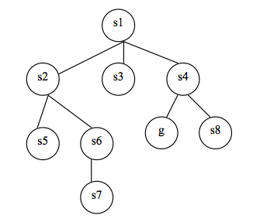
Revision: Perform a DFS using a stack

Slide 6
Revision: Perform a BFS using a queue

Slide 7
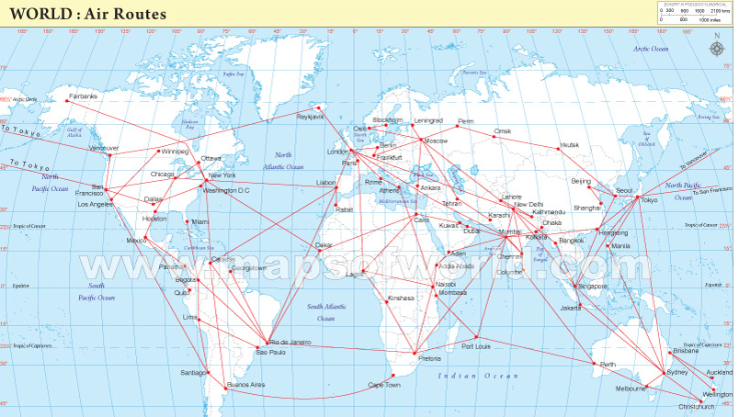
When are graphs used in real-life?

Slide 8
Graphs
Graphs are collections of vertices and edges
  Vertices are simple objects which can have names and other properties
  An Edge is a connection between two vertices

Slide 9
Graphs
Draw a graph with the following points – A B C D E F G H I J K L M with set of edges between these vertices:
AG AB AC LM JM JL JK ED FD HI FE AF GE

Slide 10
Graphs
A path from vertex x to y in a graph is a list of vertices in which successive vertices are connected by edges in the graph
A simple path is a path in which no vertex is repeated
In the previous exercise list all the possible paths from A to G

Slide 11
Graphs
A cycle is a path that is simple except that the first and the last vertex are the same
A graph with no cycles is called a tree
Are there any cycles in the previous exercise?

Slide 12
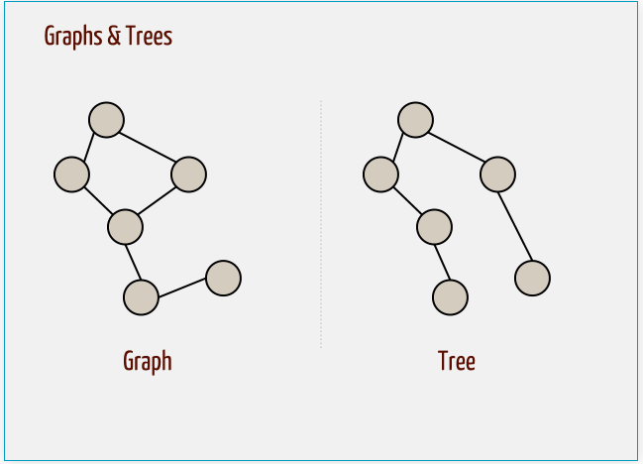
Graphs

Slide 13
Graphs
A graph is connected if there is a path from every node to every other node.
Is the graph in the previous exercise connected?

Slide 14
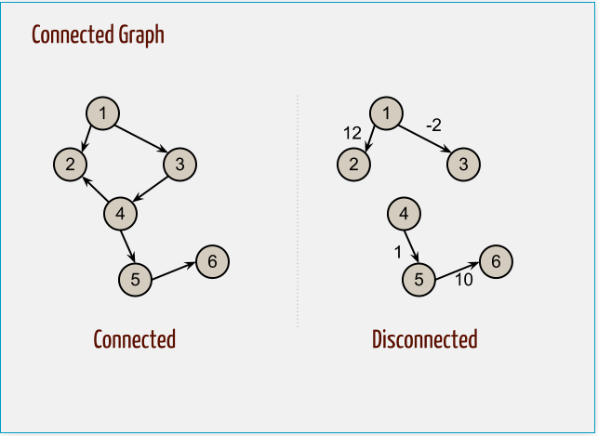
Graphs

Slide 15
Graphs
How can we find out the answers to the following questions:
  Is the graph connected?
  If not, does it have connected components?
  Does the graph have a cycle?
Use Depth-first Search or Breadth First Search

Slide 16
Graphs
How can we find out the answers to the following questions:
  Is the graph connected?
  If not, does it have connected components?
  Does the graph have a cycle?
Use Depth-first Search or Breadth First Search

Slide 17
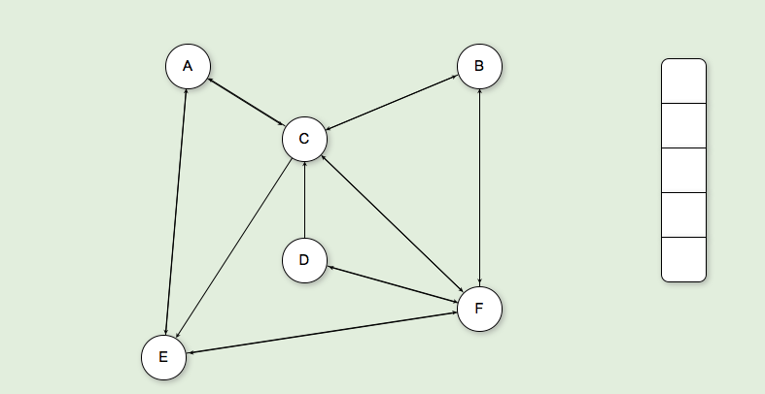
DFS Graph Traversals
http://algoviz.org/OpenDSA/Books/CS3114/html/GraphTraversal.html#

Slide 18
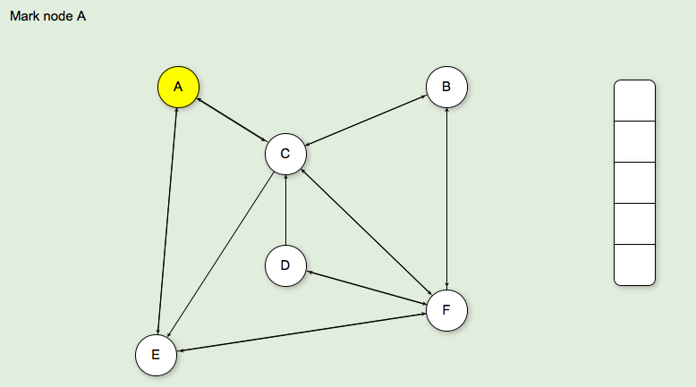
DFS Graph Traversals

Slide 19
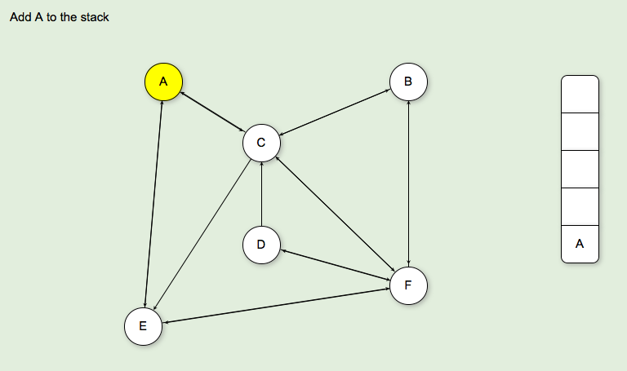
DFS Graph Traversals

Slide 20
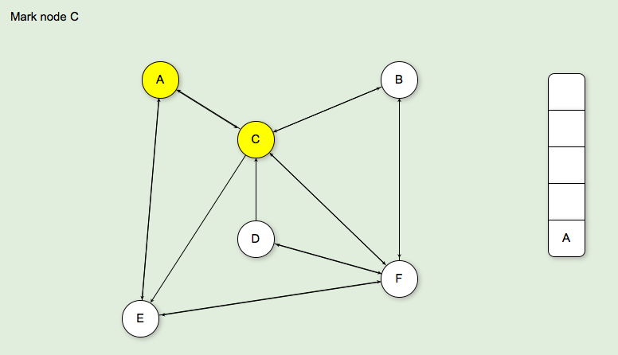
DFS Graph Traversals

Slide 21
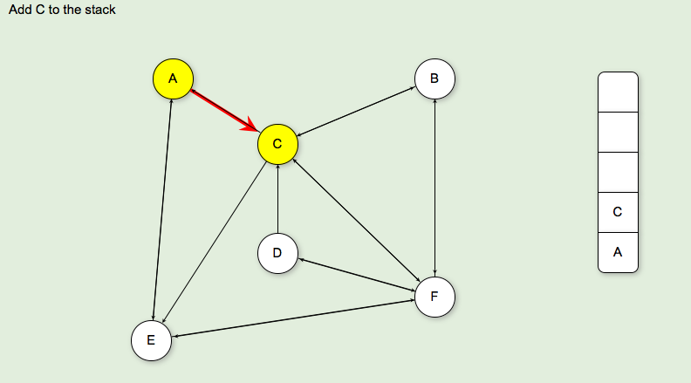
DFS Graph Traversals

Slide 22
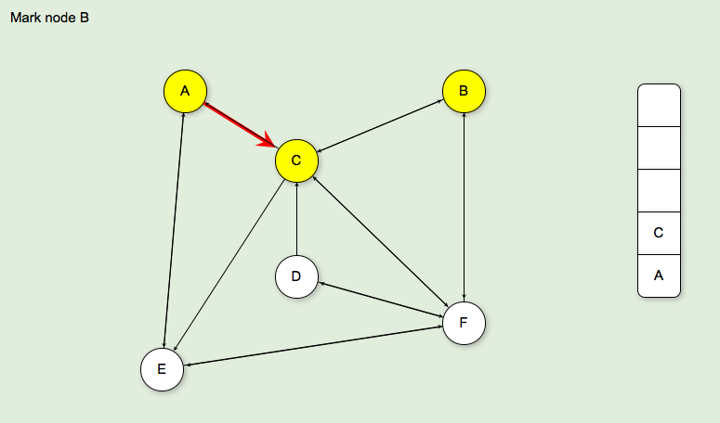
DFS Graph Traversals

Slide 23
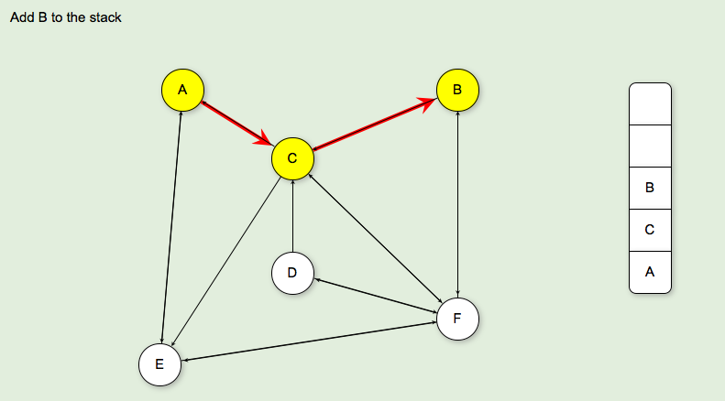
DFS Graph Traversals

Slide 24
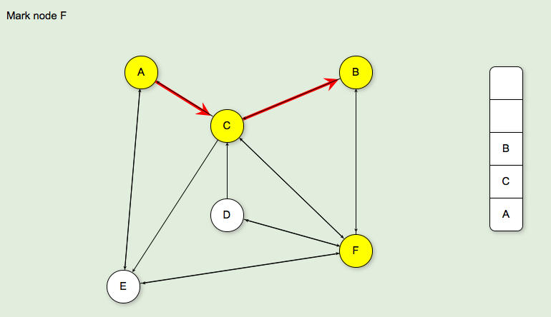
DFS Graph Traversals

Slide 25
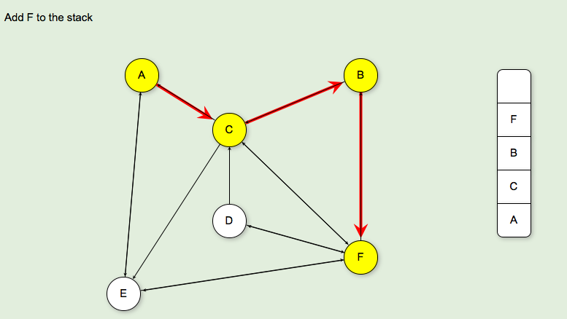
DFS Graph Traversals

Slide 26

DFS Graph Traversals

Slide 27
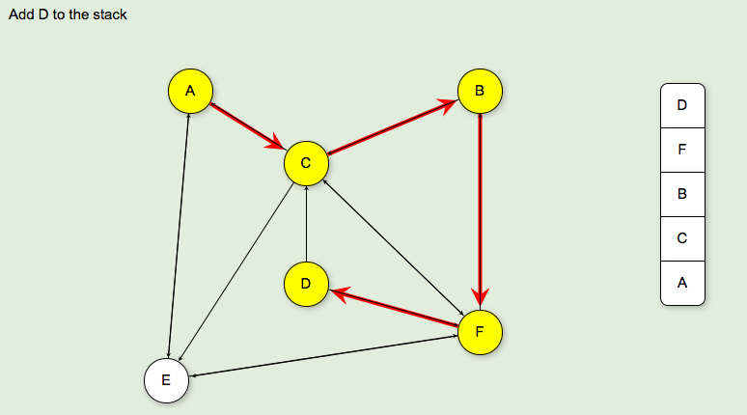
DFS Graph Traversals

Slide 28
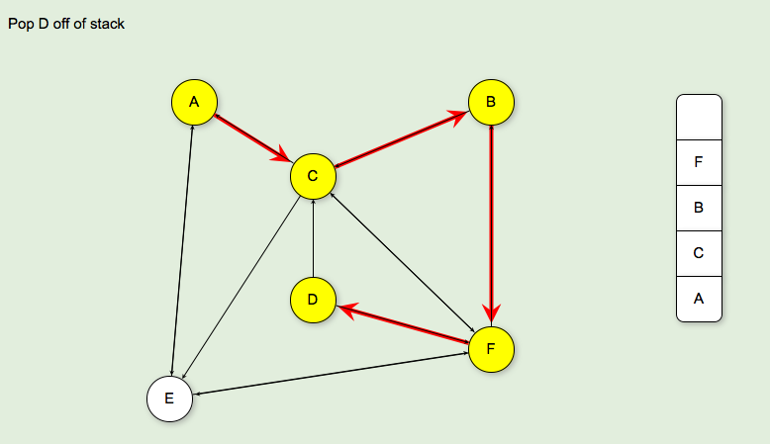
DFS Graph Traversals

Slide 29
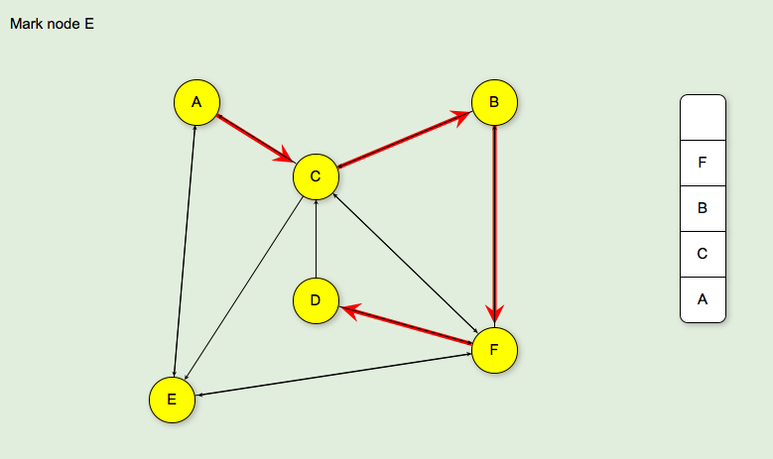
DFS Graph Traversals

Slide 30
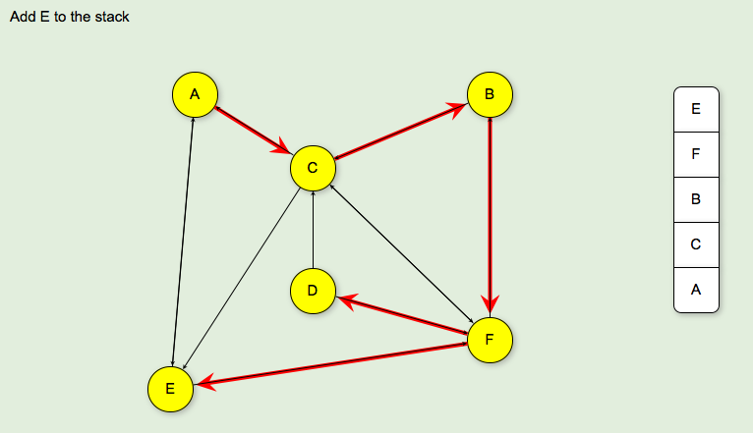
DFS Graph Traversals

Slide 31
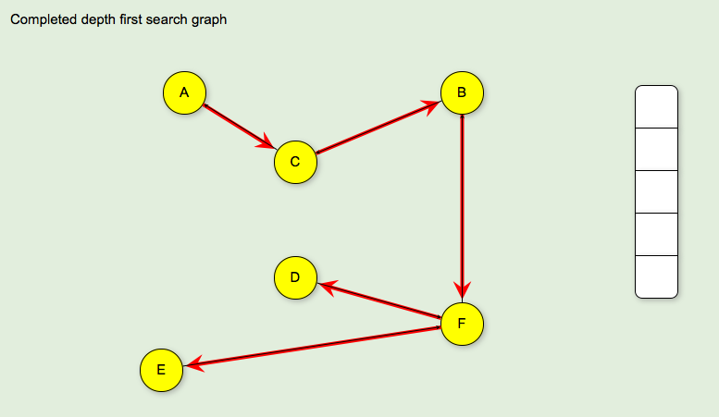
DFS Graph Traversals

Slide 32
Write DFS Graph Traversal Algorithm
DFS (node)
push node onto stack
while (stack is not empty)
if node is not visited
mark node as visited
DFS (neighbour of node)
else
Pop (node)

Slide 33
BFS Graph Traversals
BFS (int node)
Put the root node on a queue
while (queue is not empty)
remove a node from the queue
mark node as visited
put all children of node onto the queue

Slide 34
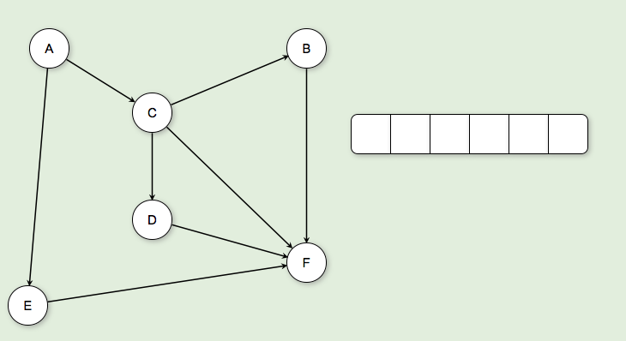
Perform BFS Graph Traversal

Slide 35
Thank You !

